Slide 1
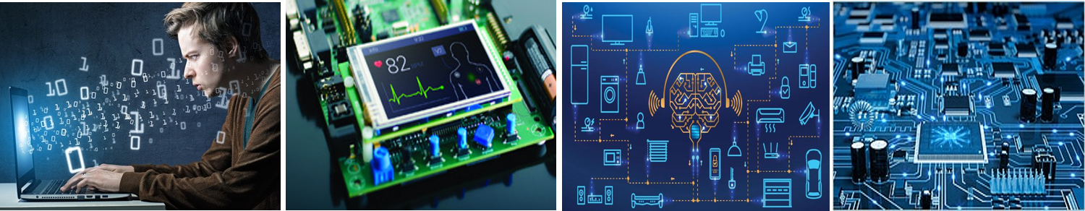
Warm Greetings All !

Slide 2
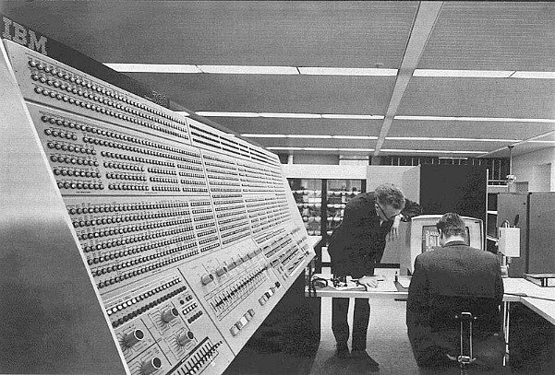
IBM COMPUTER 1950s

Slide 3
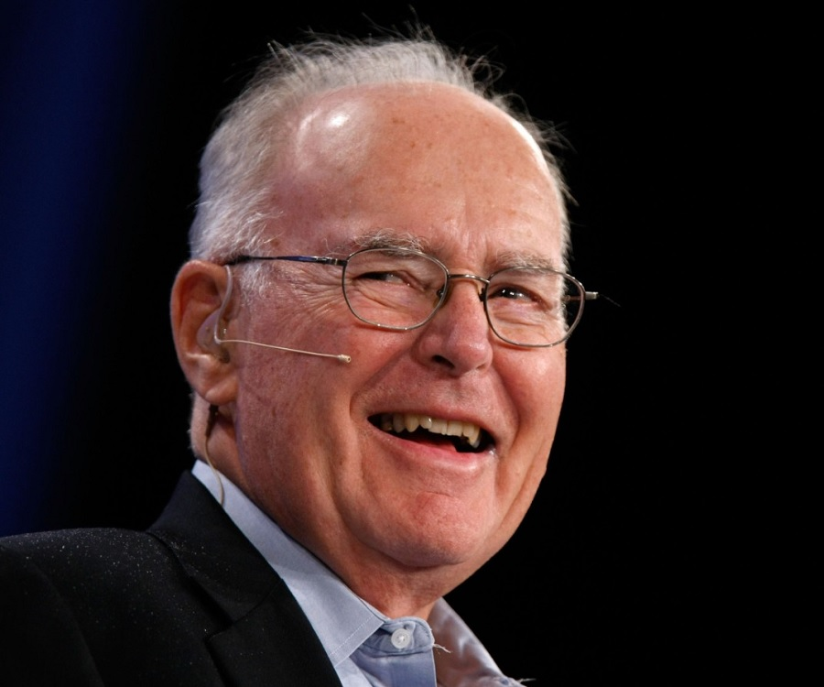

Slide 4
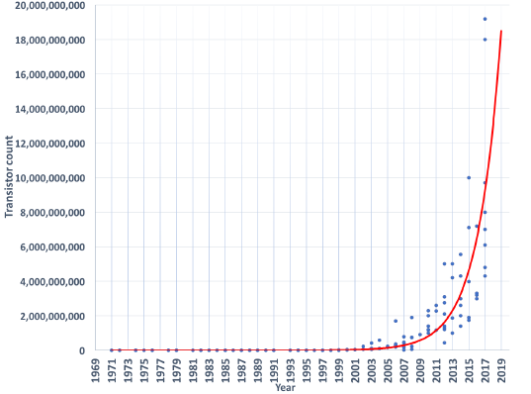
MOORE’S LAW

Slide 5
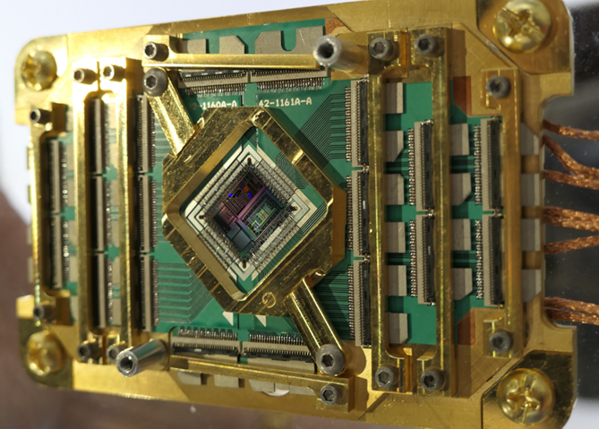
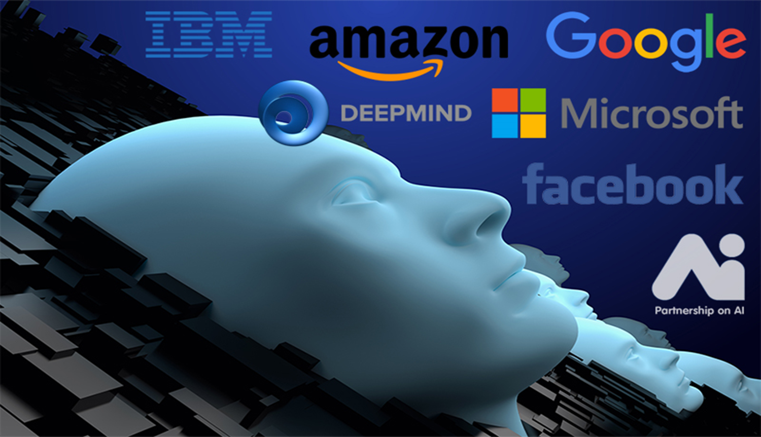
Quantum Computers
Artificial Intelligence

Slide 6
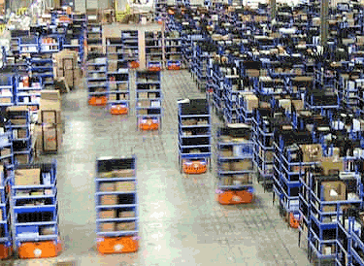
Amazon Warehouse

Slide 7
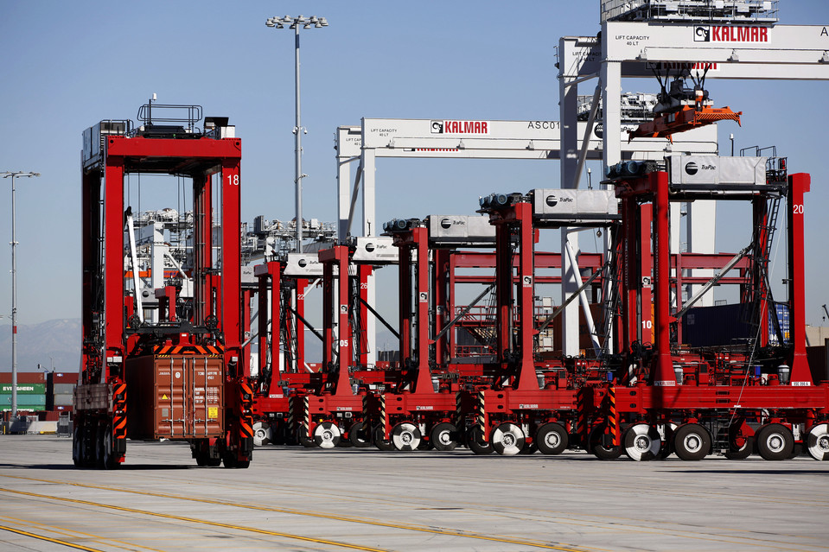
Shipping Logistics

Slide 8
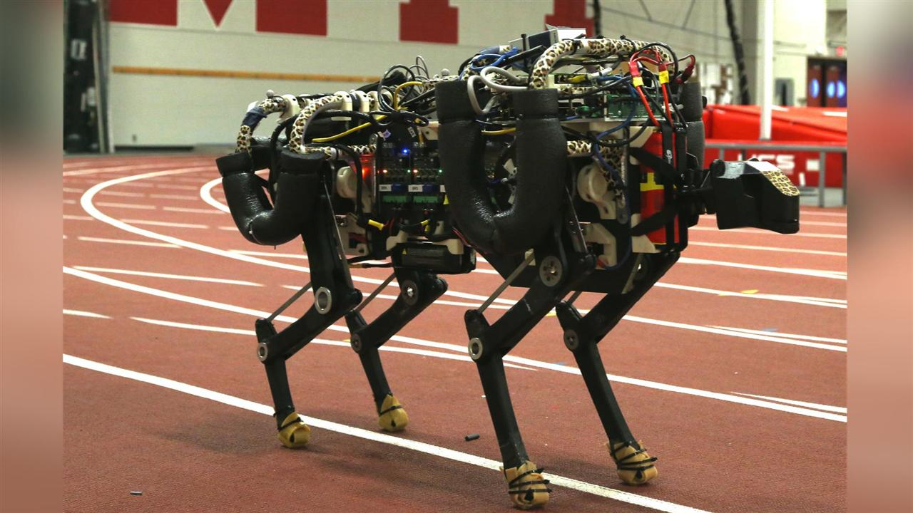
Police Bot – Cheetah (28.3 mph)

Slide 9
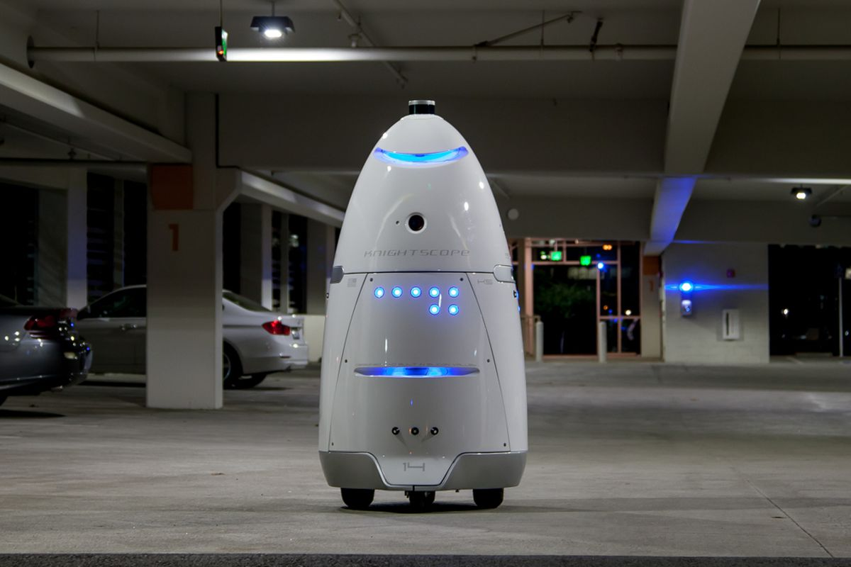
Knight Scope Robot

Slide 10
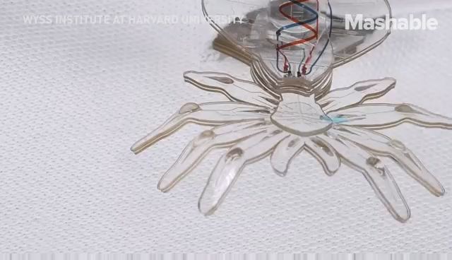
Flexible bot - spidey

Slide 11
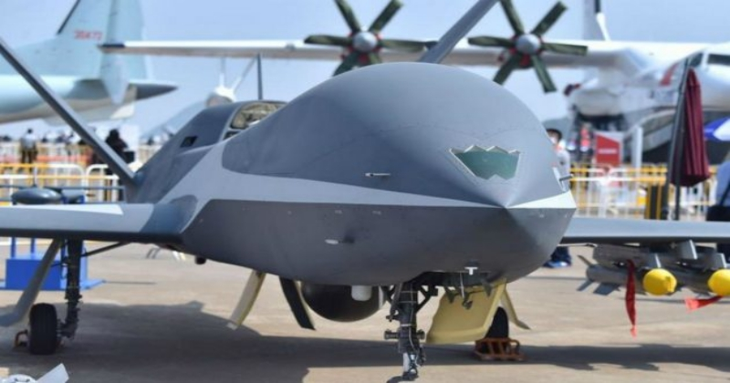
Combat Drone

Slide 12
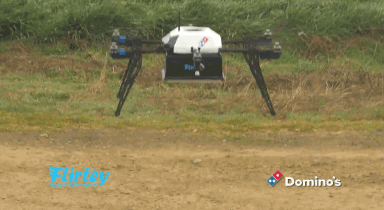
Pizza Delivery

Slide 13
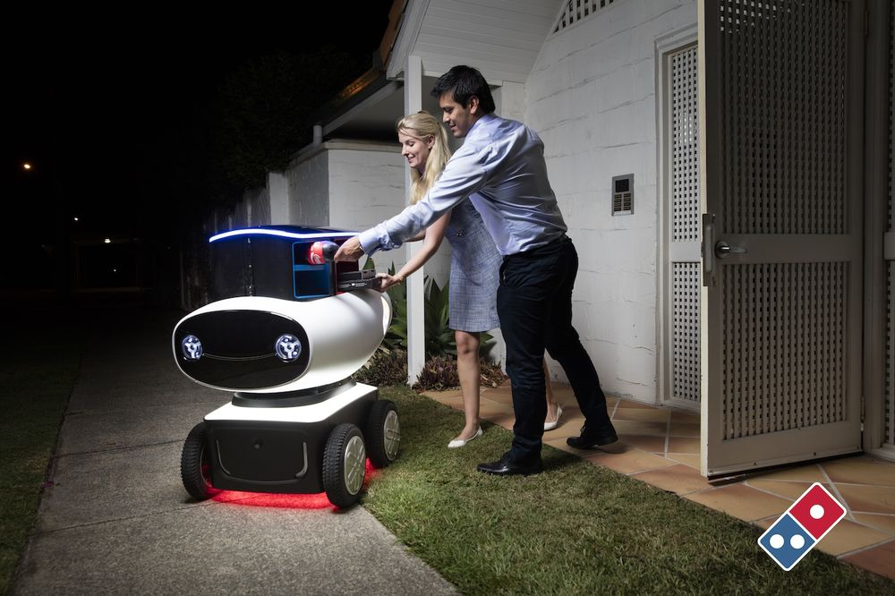
Dominos Food Product Delivery

Slide 14
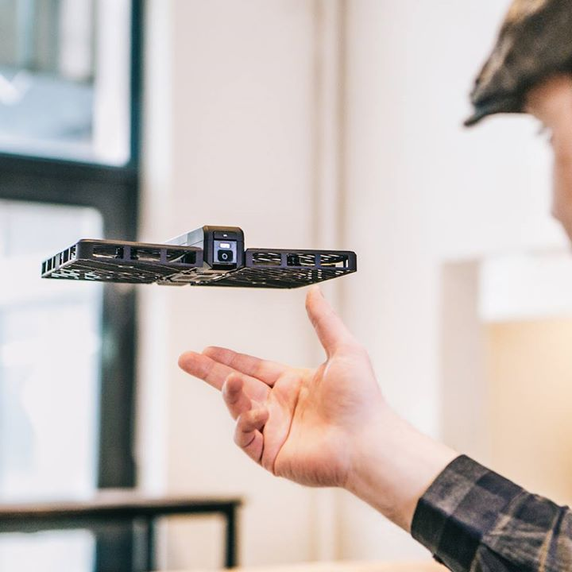

Slide 15
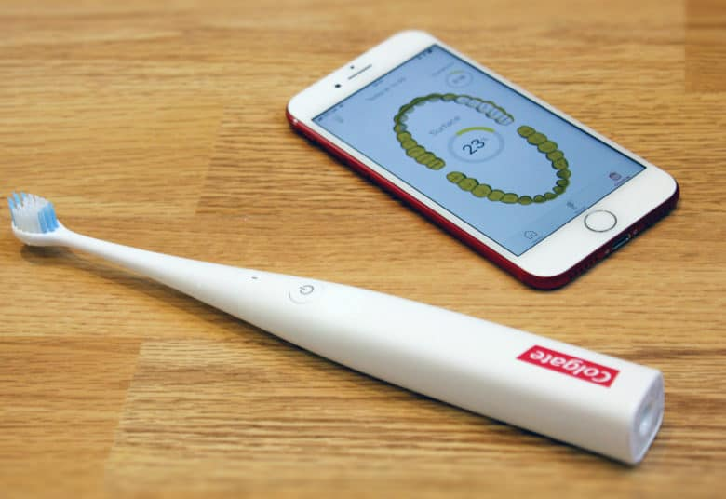
AI Tooth brush

Slide 16
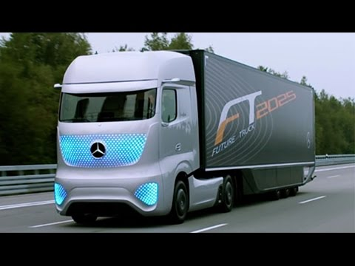
Self Driving Truck

Slide 17
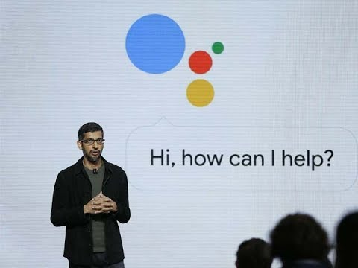

Slide 18
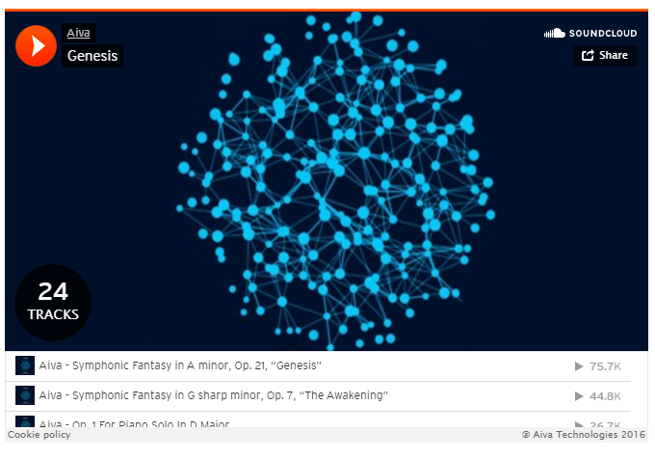

Slide 19
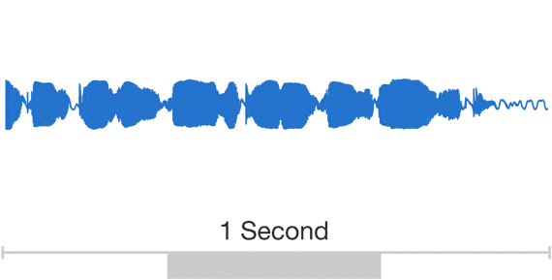

WAVENET

Slide 20
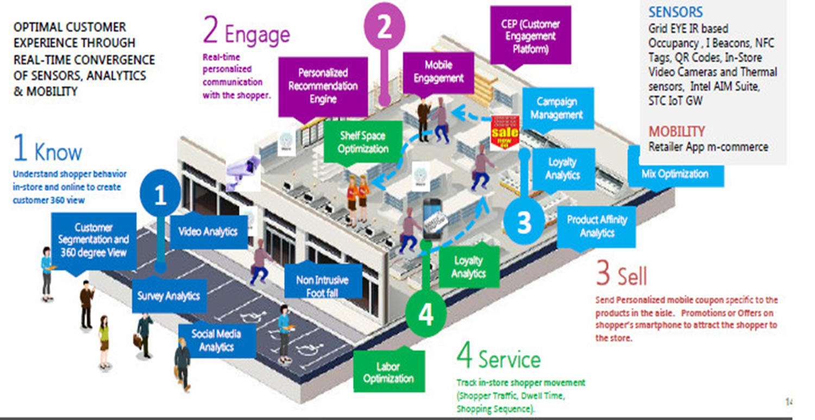
Smart retail

Slide 21
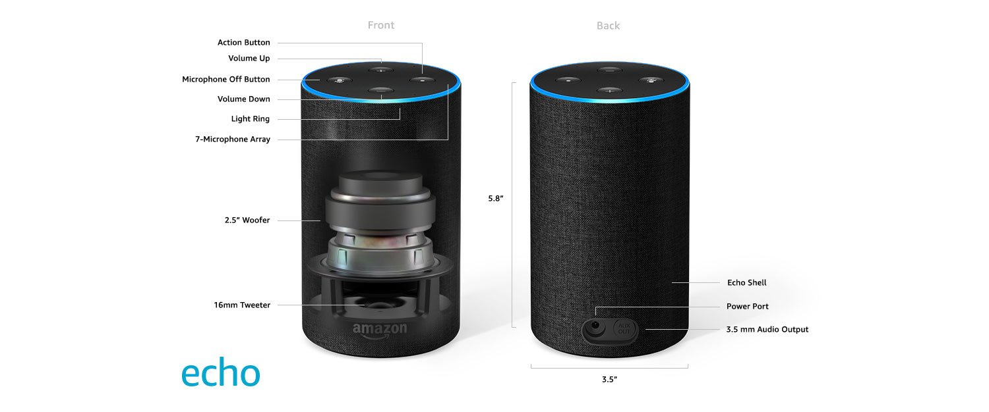
Amazon Echo

Slide 22
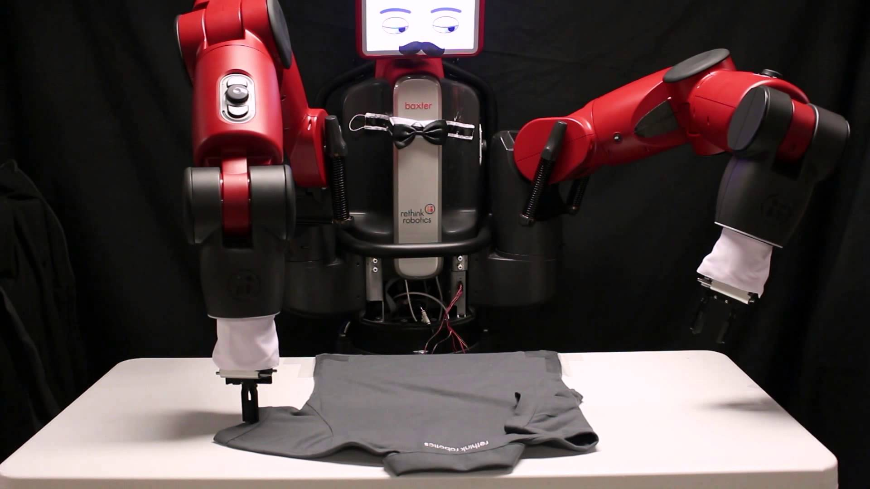
Baxter

Slide 23
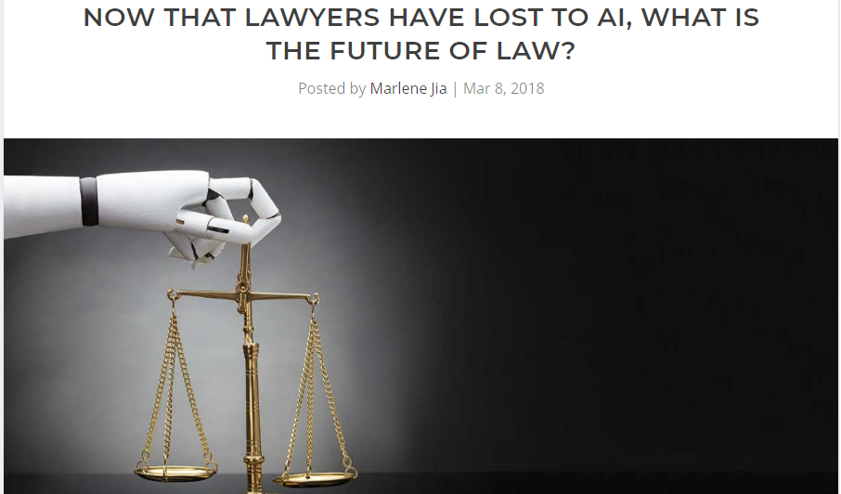
AI Lawyer (26 secs for reviewing a case)

Slide 24
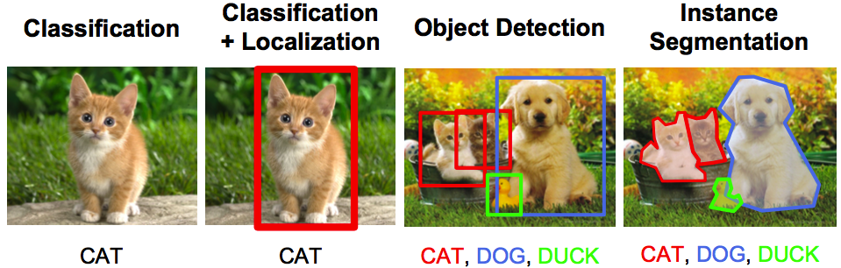
AI in Image Processing

Slide 25
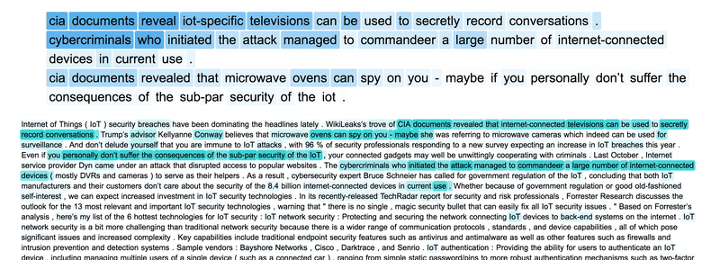
Text Summarization

Slide 26
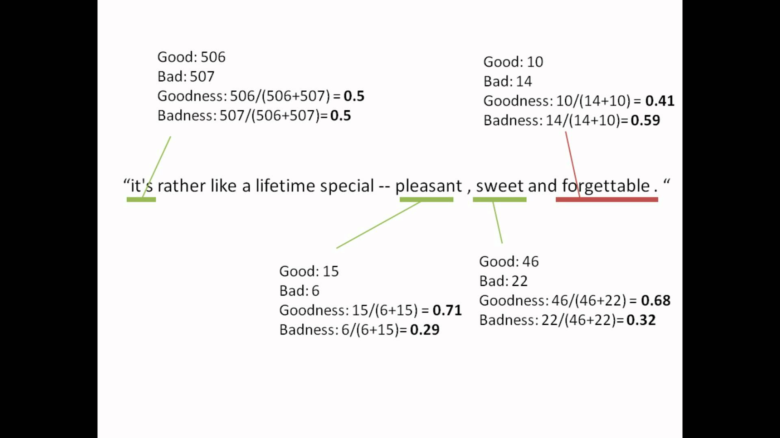
Sentiment Analysis using AI

Slide 27
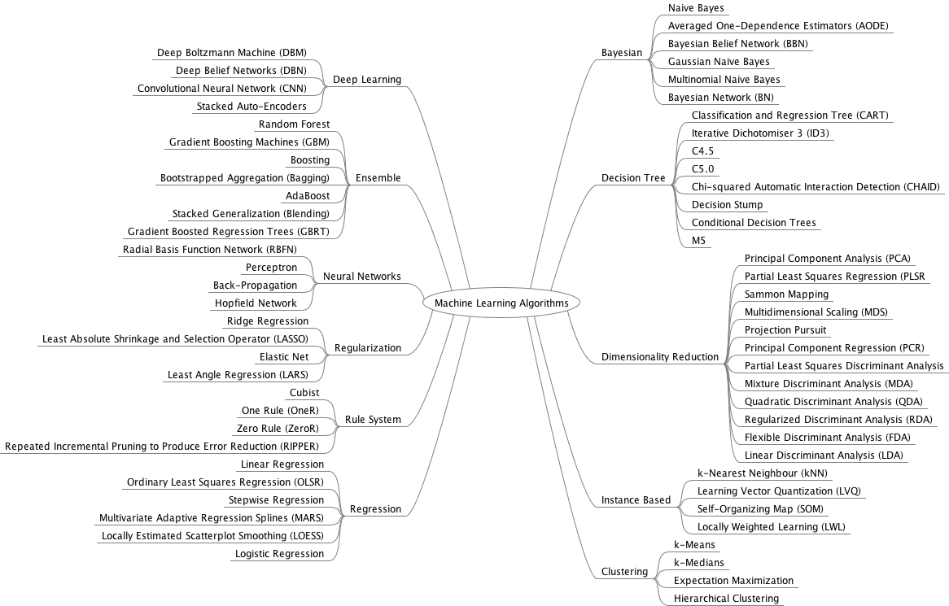
ML Algorithms

Slide 28
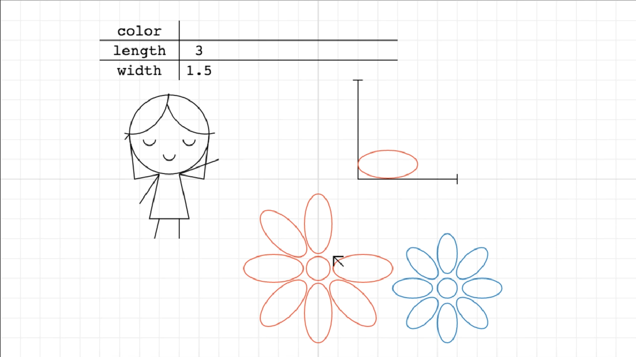
ML

Slide 29
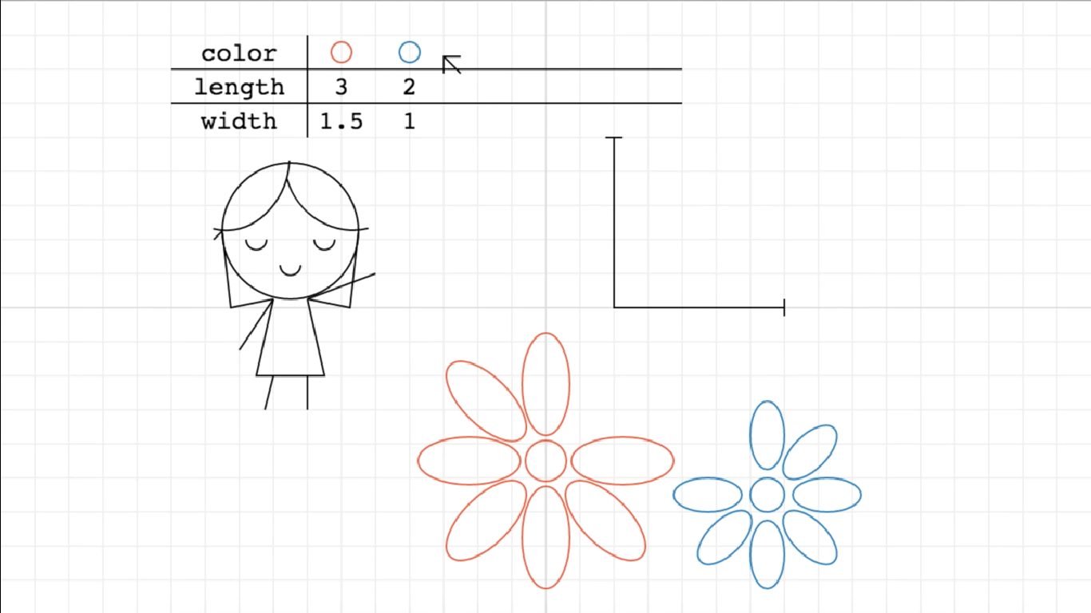
ML

Slide 30
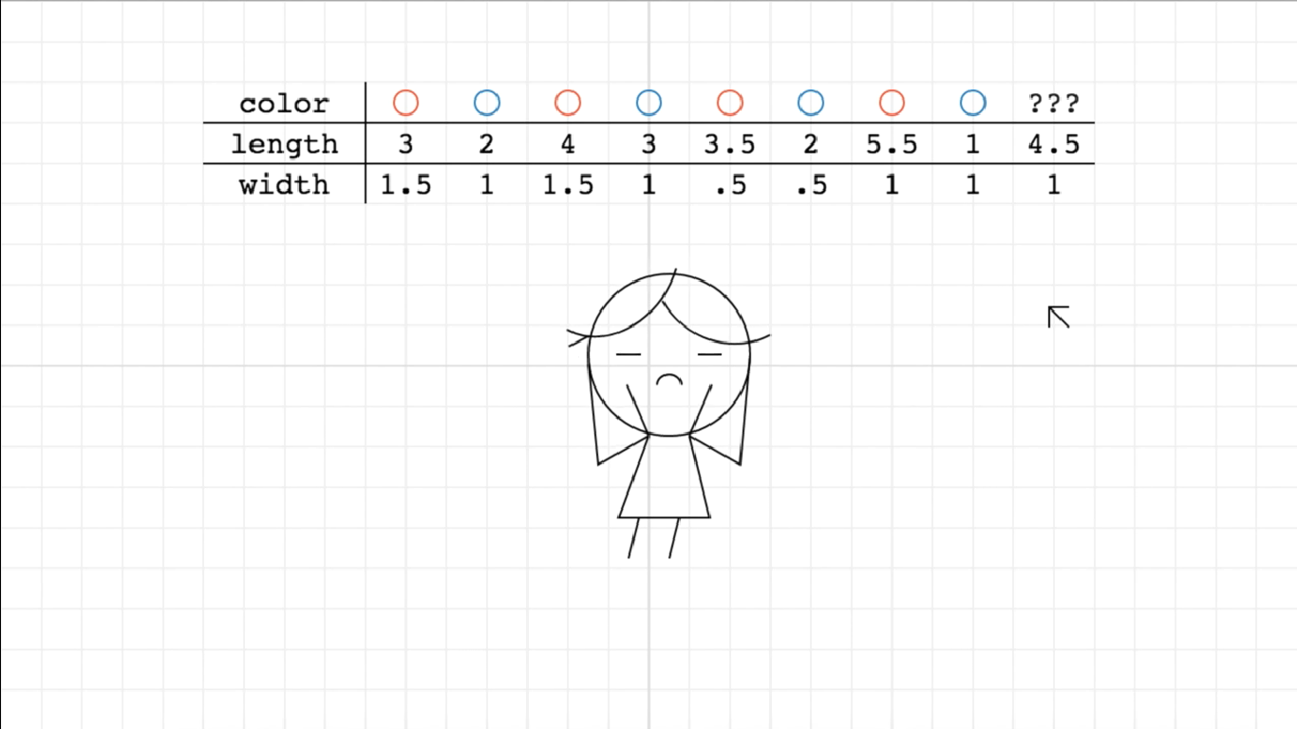
ML

Slide 31
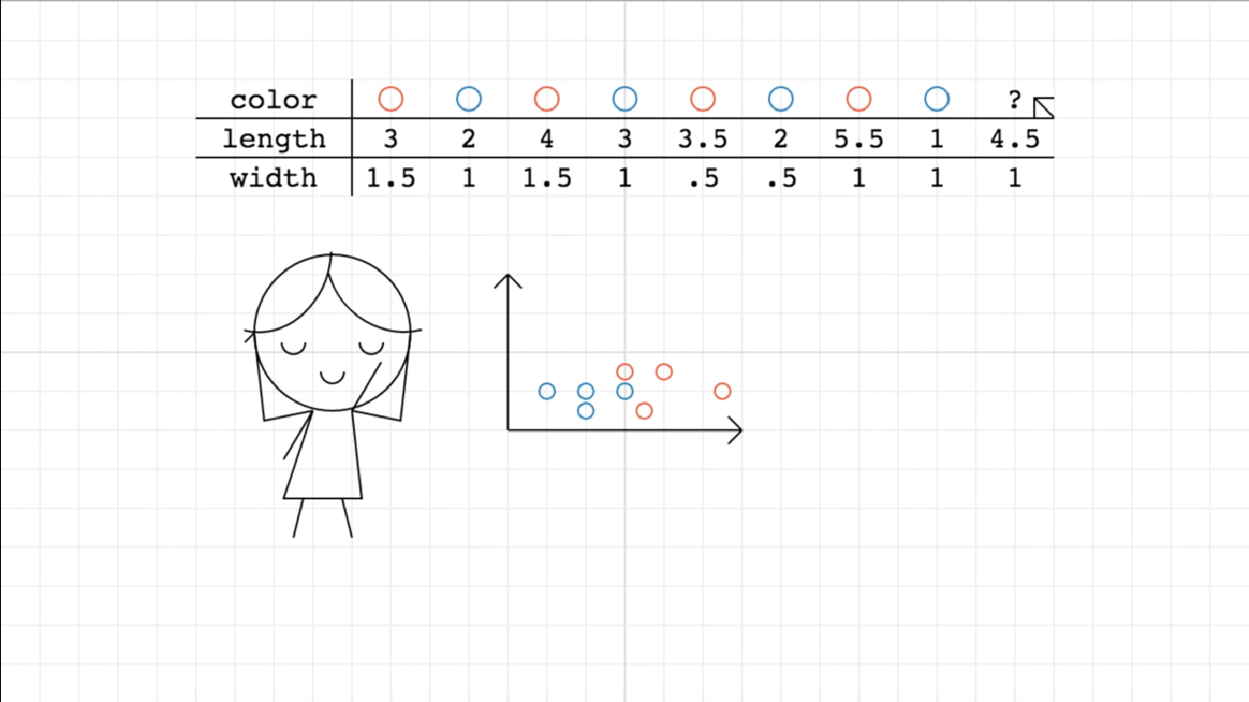
ML

Slide 32
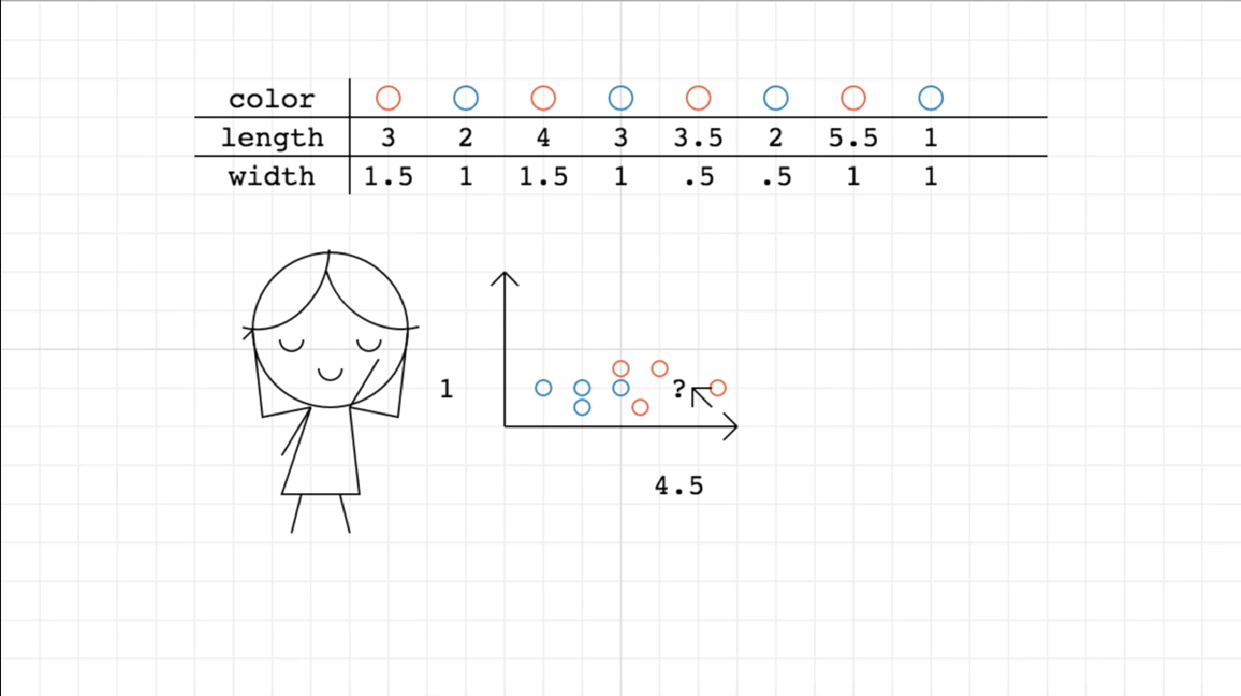
ML

Slide 33
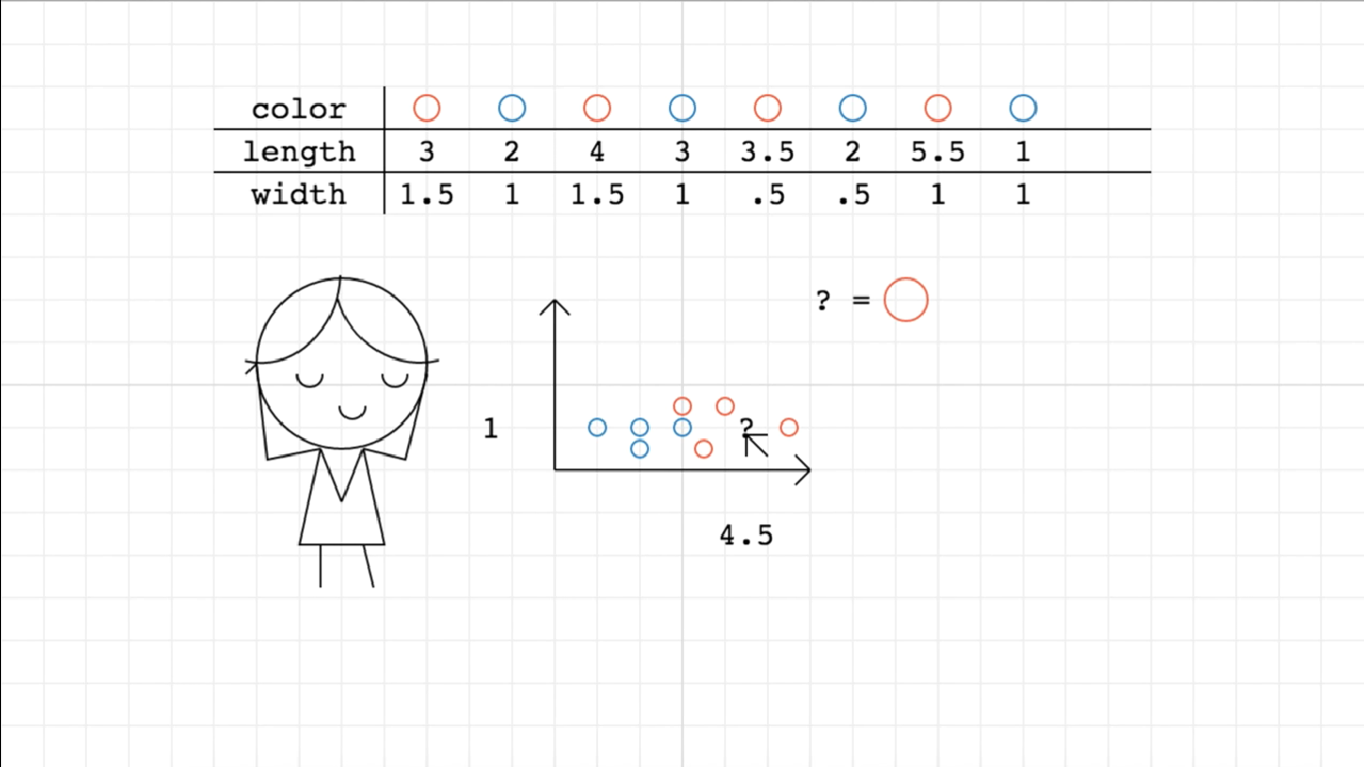
ML

Slide 34
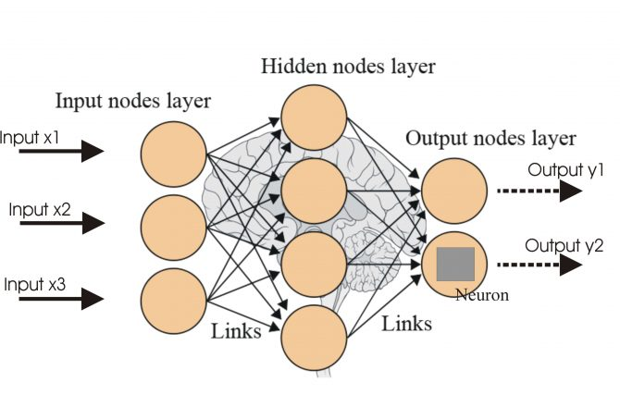
NEURAL NETWORKS

Slide 35
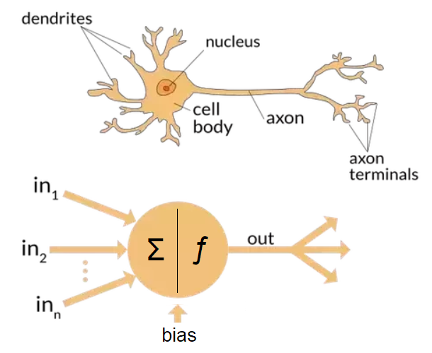
NEURON

Slide 36
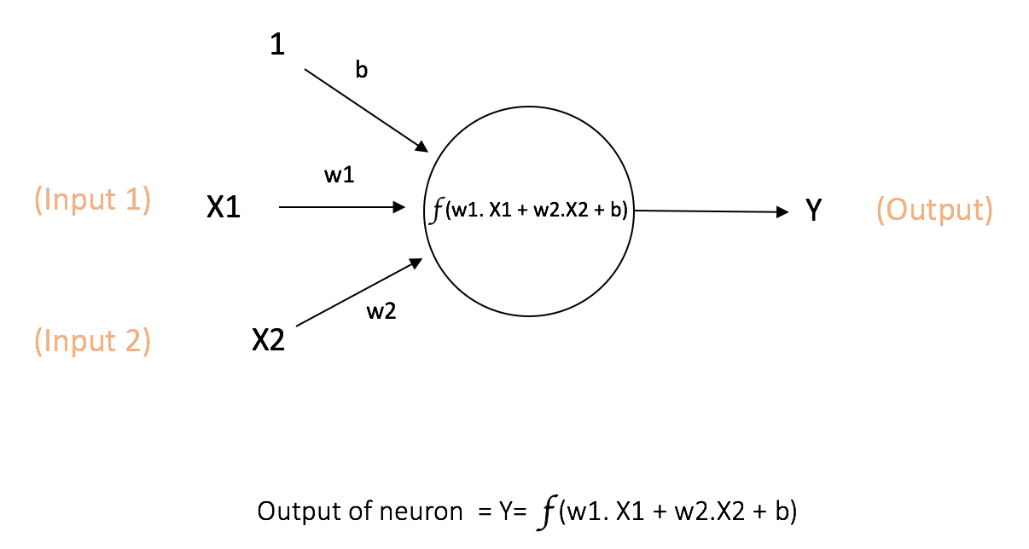
WEIGHTED SUM

Slide 37
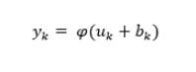
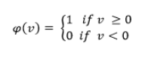
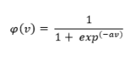
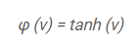
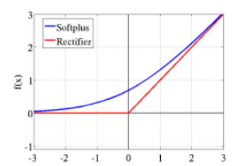
ACTIVATION
Threshold Function
Sigmoid Function
Hyperbolic Tangent
Rectified Linear Activation Function (ReLU)
Maxout Function

Slide 38
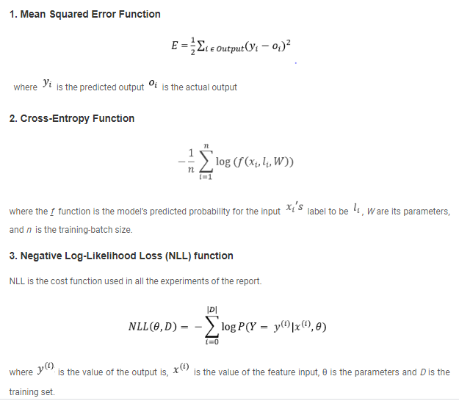
Cost function

Slide 39
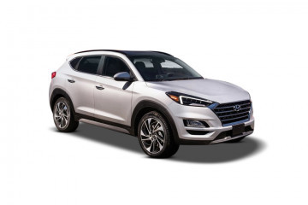
Practical Scenario
L
1
W1, b1
0
R
W2, b2
0
W3, b3
out
1
F
W4,b4
-1
SUG

Slide 40
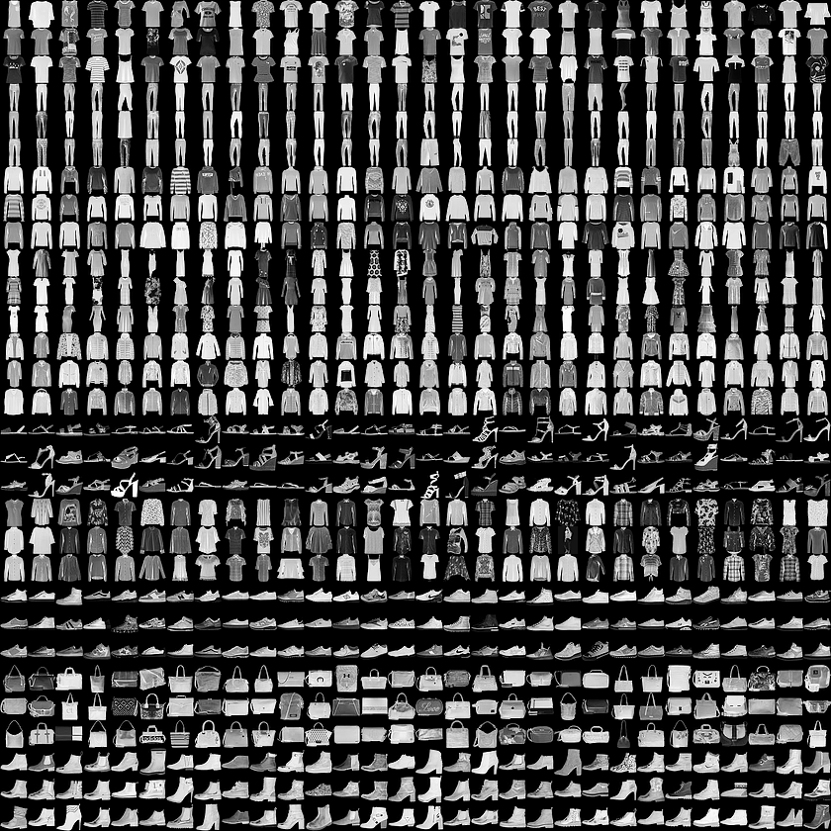
MNIST CLOTHING DATA

Slide 41
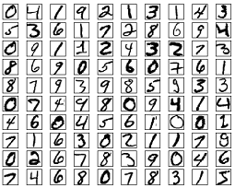
MNIST – Handwriting data

Slide 42
Deep Learning

Slide 43
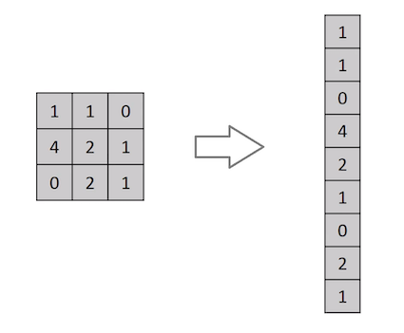

MNIST Data set vs real time images

Slide 44

Convolution Neural Network

Slide 45

Convolution Layer or Kernal

Slide 46

Kernal for all RGB Layers

Slide 47

Padding and Strides

Slide 48

Pooling Layer – max or avg

Slide 49
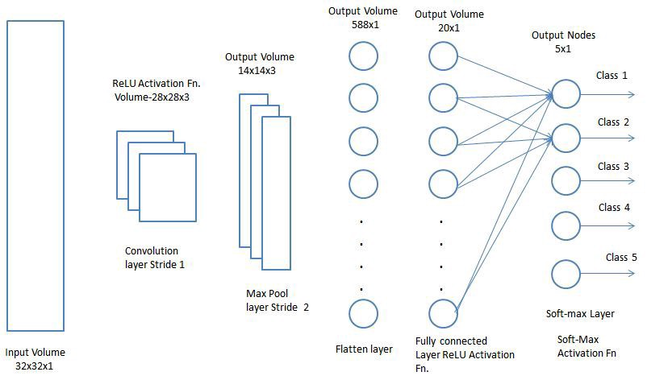
Classification – fully connected layer

Slide 50
Available architectures of CNN
LeNet
AlexNet
VGGNet
GoogLeNet
ResNet
ZFNet

